Slide 1






Bootcamp
The World of Information Technology IT (2)
Session 4
Jeans Hernández
11/03/2024

Slide 2


Desarrollo Web Full Stack -
Avanzado
Módulo 1. Welcome / Famous People in IT
Módulo 2. Jobs in IT
Módulo 3. The World of Information Technology IT (1)
Módulo 4. The World of Information Technology IT (2)
Módulo 5. Roles and Tasks in an IT Company
Módulo 6. Virtual calls
Módulo 7. Daily meetings
Módulo 8. CV (Curriculum Vitae) (1)

Slide 3
Table of contents
1
The world of information technology

Slide 4

Objectives:
The world of information technology
Recognize and effectively use word, pronoun and determiner formations

Slide 5

Watch the video and answer the questions
What is programming?
What components do computers use and what is the main language of computers?
What does Assembly do?
What is Scratch?
What are some examples of high-level programming languages mentioned in the video, and why are they preferred over low-level languages
Is HTML a programming language? What is it used for?

Slide 6

Give Spanish equivalents and remember the meaning of key words and phrases.
Use Wordreference/Deepl if needed.
Key words
Programming language
Sequence of instructions
Application domain
Coding basics
Syntax
Machine Code
Statements
Client-server application
Script
Time-consuming

Slide 7
Formation of technical phrases in IT
The fast-paced world of IT demands clear and concise communication. Technical phrases are formed using several methods to achieve this, with prefixes, suffixes, and abbreviations being the most common. Here's a breakdown:
1. Affixation (Prefixes & Suffixes):
Prefixes: These are syllables added to the beginning of a word to change its meaning. For example: "reboot" (restarting a computer), "download" (transferring data from a server), "preview" (seeing something before it's final).
Suffixes: These are syllables added to the end of a word to create a new word or change its part of speech. Examples: "firewall" (a security barrier), "package" (a collection of software), "connect” (to establish a link).

Slide 8
Formation of technical phrases in IT
Acronyms and Initialisms:
Acronyms: These are formed by taking the first letters of multiple words and pronouncing them as a new word. Examples: "RAM" (Random Access Memory), "USB" (Universal Serial Bus), "GPU" (Graphics Processing Unit).
Initialisms: Similar to acronyms, but pronounced as individual letters. Examples: "API" (Application Programming Interface), "HTML" (Hypertext Markup Language), "VPN" (Virtual Private Network).

Slide 9

Reading Activity
Read and write 3 things you have learned from the article that you want to remember, and exchange information with your classmates.
Example:
I learned that the Mississippi River is the longest river in North America.
It is home to more than 300 different types of animals.
The name "Mississippi" is from a Native American word that means "big river."
EXERCISE

Slide 10
Information Technology
1. What is the definition of Information Technology as mentioned in the video?
2. Where is Information Technology applicable, give examples?
4. What are some examples of tangible devices (hardware) used in Information Technology?
5. What are the 2 main groups of intangible software.
6. What are some potential job opportunities in the field of Information Technology?

Slide 11
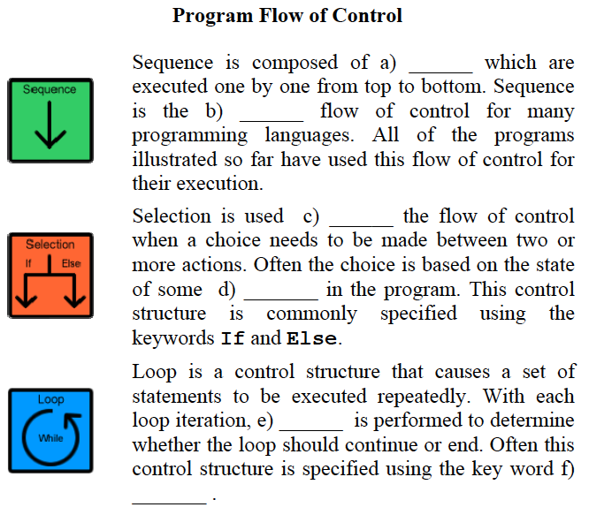
Elements of programming.
Control Structures.
Use the correct word to fill in the gaps in the following sentences.
a series of statements
variables
default
a single logical operation
default
a subprogram
to alter
a series of statements
variables
a test
to alter
while

Slide 12
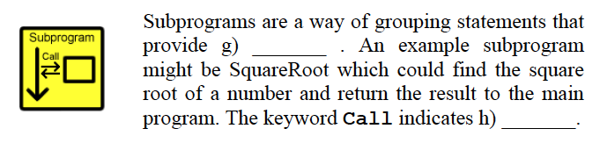
Elements of programming.
Control Structures.
Use the correct word to fill in the gaps in the following sentences.
to test
variables
while
a single logical operation
default
a subprogram
a single logical operation
a series of statements
a subprogram
to test
to alter
while

Slide 13

TEST YOUR KNOWLEDGE

Slide 14


